Slide 1
Consumer Behaviour
Unit- 2

Slide 2
Revise
Q1) Draw and explain Determinants of demand
Q2) Law of diminishing marginal utility
Q3) Law of demand

Slide 3
Indifference Schedule
Combination | Good-X | Good-Y
A | 2 | 18
B | 4 | 13
C | 6 | 9
D | 8 | 6

Slide 4
Pears | Oranges | Point in figure
30 | 6 | a
24 | 7 | b
20 | 8 | c
14 | 10 | d
10 | 13 | e
8 | 15 | f
6 | 20 | g

Slide 5
Indifference curve
An indifference curve is the locus of the combination of two goods that are equally satisfactory to the consumer or to which the consumer is indifferent.
It is a graph of an indifferent schedule.

Slide 6
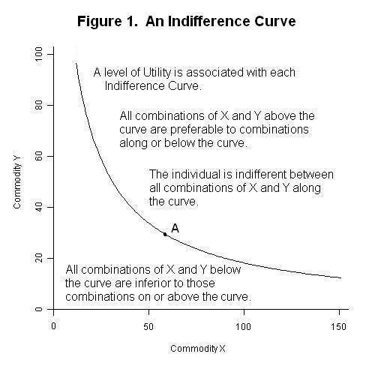
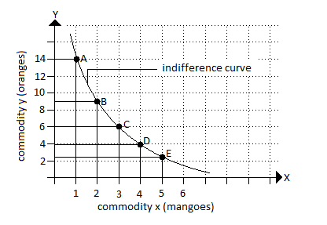

Slide 7
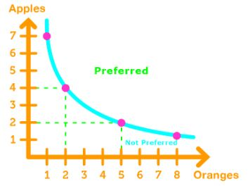

Slide 8
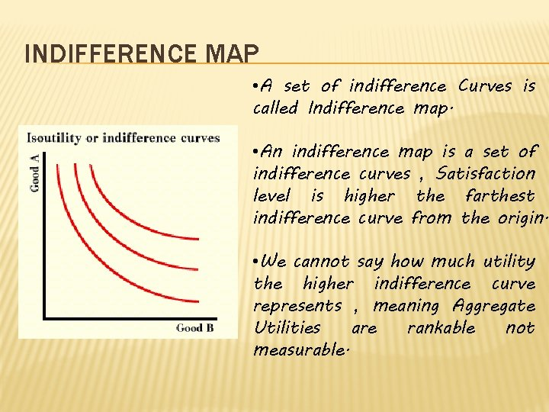
Indifference map
An indifference map may show all the indifference curves which rank preferences of the consumer.

Slide 9
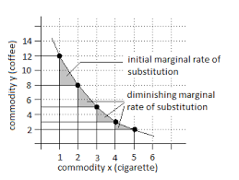
The slope of the indifference curve is called the “ Marginal rate of substitution”

Slide 10
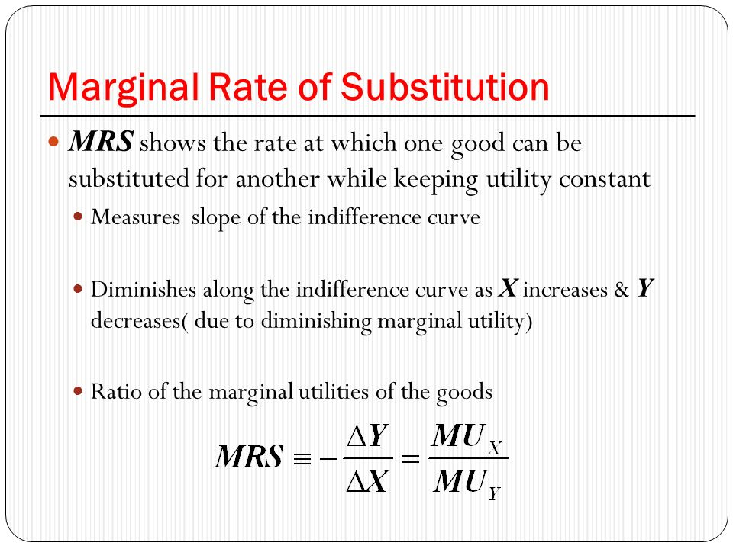

Slide 11
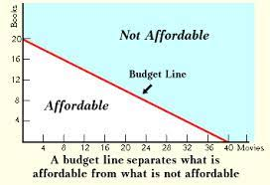
Budget line

Slide 12
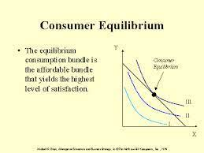
Consumer Equilibrium

